Slide 1
Project Management
Website BDE

Slide 2
Sommaire
Context
Communication
Planning
Tasks management
Risks
Human
Equipment
Knowledge
Percentage achieved
Charter
Conclusion

Slide 3




Communication

Slide 4
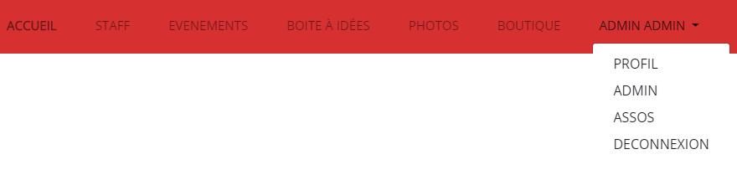
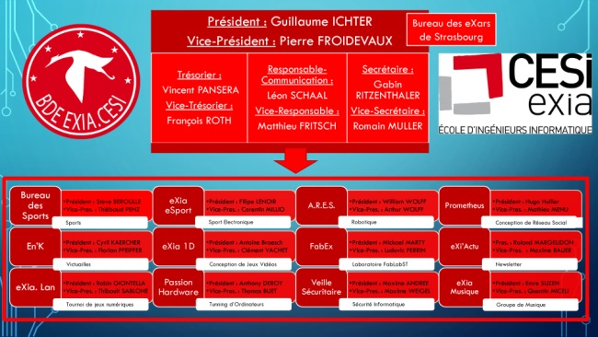
Context
Our navigation bar :
: BDE Website example

Slide 5
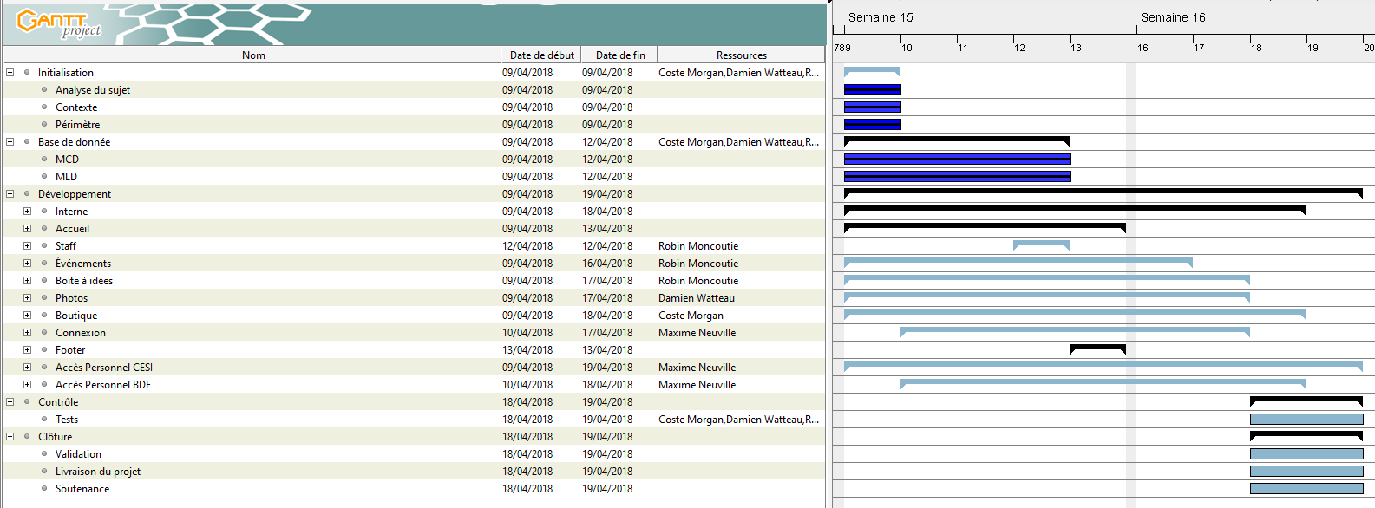
Planning

Slide 6
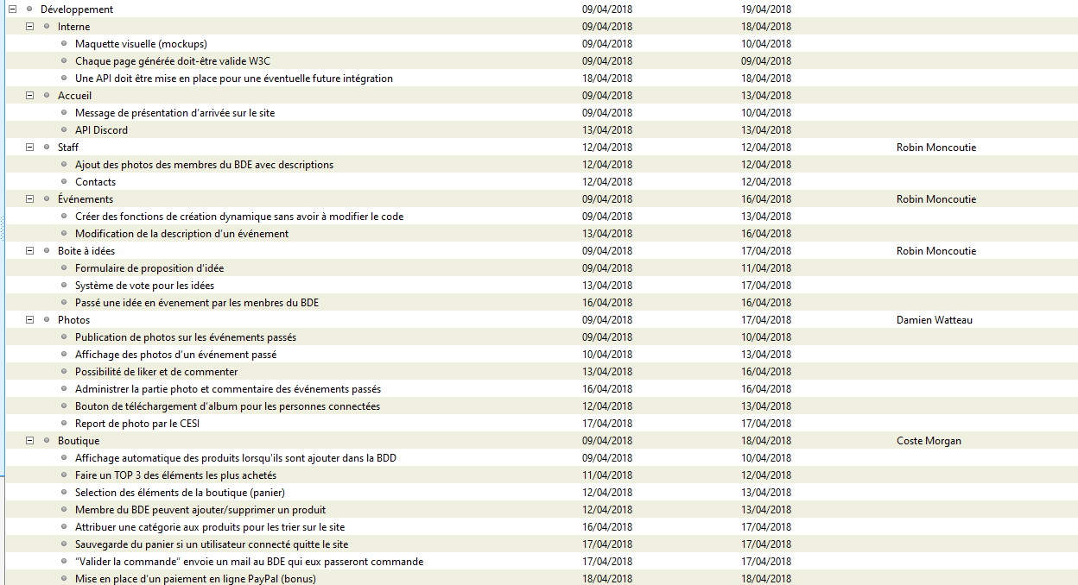

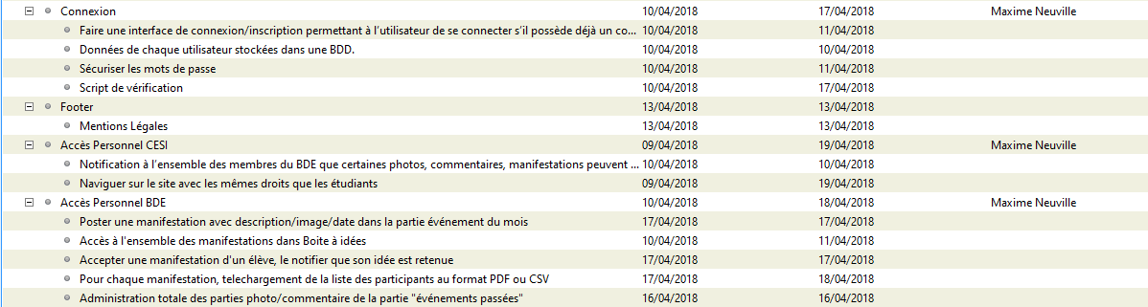
Tasks management

Slide 7

Risks - Human

Slide 8



Risks - Equipment

Slide 9



Risks - Knowledge

Slide 10

Percentage achieved
Time left to end : ~25h

Slide 11
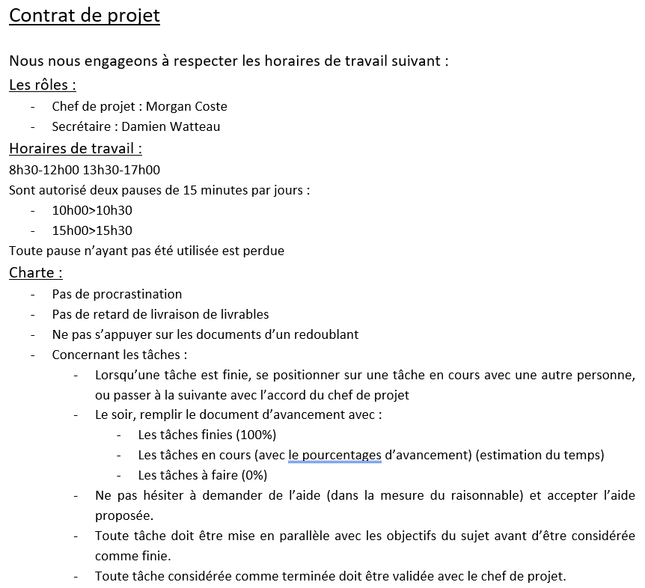
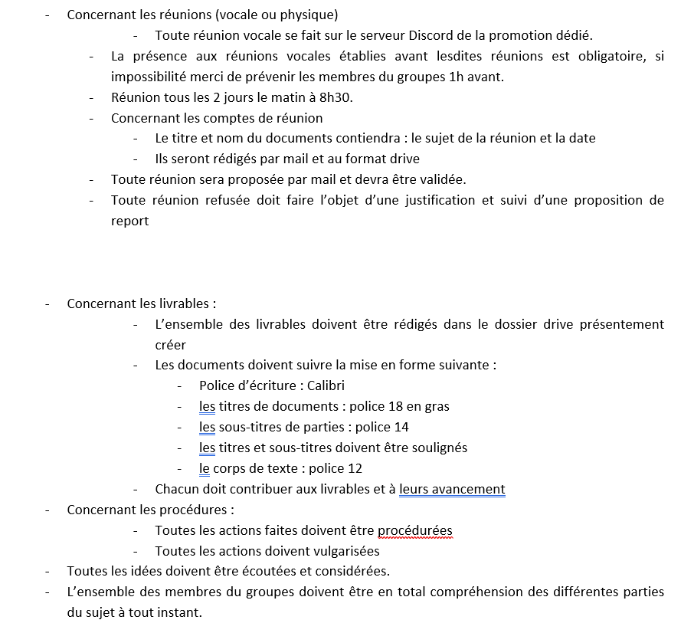
Charter

Slide 12


Conclusion

Slide 13
Thanks you
DO YOU HAVE QUESTIONS ?

